Slide 1

DIGITAL PORTFOLIO
STUDENT NAME: PRIYADARSHINI P
REGISTER NO : 222404454
NMID: 2F27F99731843A69D6B4A7B7E0A58FE4
DEPARTMENT: B.SC COMPUTER SCIENCE
COLLEGE: A.M.JAIN COLLEGE
UNIVERSITY: MADRAS UNIVERSITY

Slide 2

PROJECT TITLE
MY PORTFOLIO – MY JOURNEY TO BECOME A GOVERNMENT OFFICER

Slide 3



AGENDA
Problem Statement
Project Overview
End Users
Tools and Technologies
Portfolio design and Layout
Features and Functionality
Results and Screenshots
Conclusion
Github Link
3/21/2024 Annual Review

Slide 4

PROBLEM STATEMENT
TO CRACK COMPETATIVE EXAM
I WANT TO BRING POSITIVE IN SOCIETY
TO SERVE THE NATION WITH HONESTY AND DEDICATION

Slide 5


PROJECT OVERVIEW (COMPETATIVE EXAM)
ABOUT ME
WHY I CHOOSE THIS PATH
PREPARATION STRATEGIES
CAREER GOALS
ACHIEVEMENTS
SKILLS

Slide 6


WHO ARE THE END USERS?
SOCIETY AND CITIZENS
GOVERNMENT DEPARTMENTS
STUDENTS AND JOB SEEKERS

Slide 7


TOOLS AND TECHNIQUES
CURRENT AFFAIRS
NOTE MAKING TOOLS
NCERT BOOKS (6 TO 12)
PREVIOUS YEAR QUESTION PAPERS
MOCK TEST

Slide 8
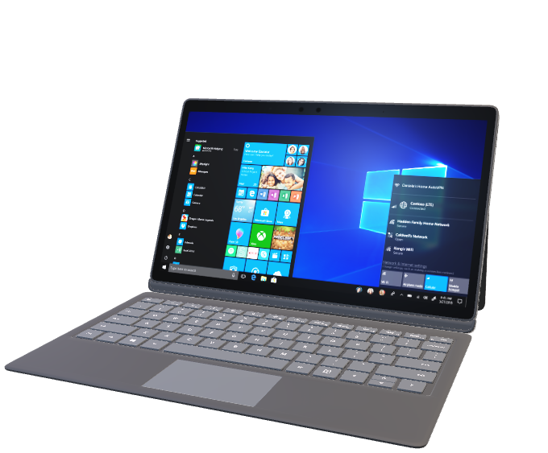
PORTFOLIO DESIGN AND LAYOUT
POWERPOINT
VISUAL STUDIO CODE
GITHUB PAGES
WEBSITES
8

Slide 9
FEATURES AND FUNCTIONALITY
LEADERSHIP QUALITIES
DECISION-MAKING
DISCIPLINE AND COMMITMENTS
HONESTY AND HARD WORK
TIME MANAGEMENT

Slide 10
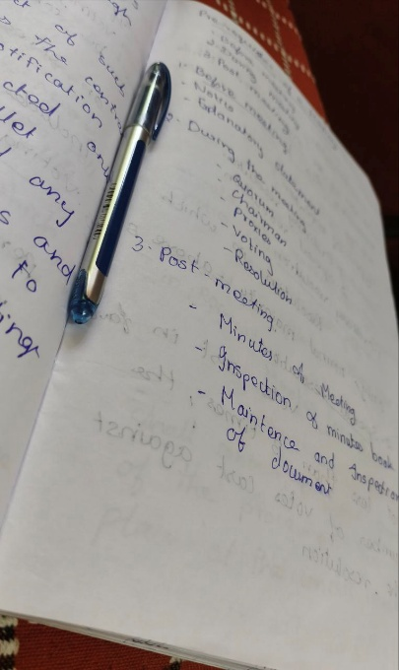

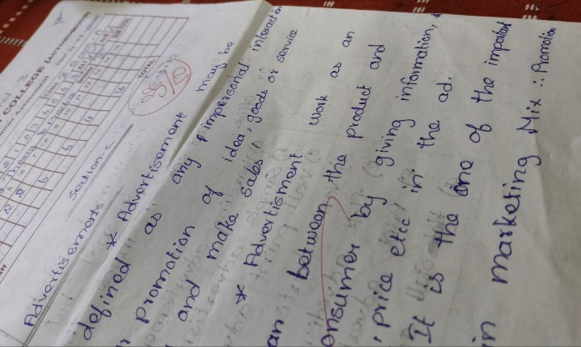
RESULTS AND SCREENSHOTS
SAMPLE NOTES
MOCK TEST
3/21/2024 Annual Review
10

Slide 11

CONCLUSION
“IT WON’T BE EASY, BUT IT WILL BE WORTH IT”
‹#›

